Slide 1
DELAUNAY TRIANGULATION

Slide 2
DELAUNAY TRIANGULATION
Designed by Boris Delaunay in 1934
Creates triangulation for given set of points on plane such that no point is inside the circumcircle of any triangle.
Maximize the minimum angle of all the angles of the triangles.
If the points lie on the same line, then there is no Delaunay triangulation.

Slide 3
Different Approaches
Incremental O(n²)
Divide and Conquer O(n logn)

Slide 4
ALGORITHM (DIVIDE AND CONQUER)

Slide 5
6
10
4
3
7
1
5
9
2
8

Slide 6
6
10
4
7
3
1
5
9
2
8

Slide 7
6
10
4
7
3
1
5
9
2
8

Slide 8
6
10
4
7
3
1
5
9
2
8

Slide 9
6
10
4
7
3
1
5
9
2
8

Slide 10
6
10
7
9
8

Slide 11
6
10
7
9
8

Slide 12
6
10
7
9
8

Slide 13
4
3
1
5
2
8

Slide 14
6
10
4
7
3
1
5
9
2
8

Slide 15
4
7
3
1
5
9
2
8

Slide 16
APPLICATIONS
Image Recognition
Terrain representation
Automated driving
Image Morphing

Slide 17
IMAGE MORPHING
Morphing is a special effect in motion pictures and animations that changes one image into another through a seamless transition.

Slide 18
How Morphing is done?
Step 1: Extract the facial features for each image. We used the dlib library to obtain 68 facial features.
Step 2: Find the average of these facial features.
Step 3: Calculate the Delaunay triangulation (DEL_T) for these average feature set.
Step 4: Using DEL_T, obtain the corresponding triangulations for source and target image. Note that these need not be delaunay. We will call them SRC_T, TARGET_T

Slide 19
Facial Feature Extraction
Delaunay Triangulation for average features
Triangulation for original source images based on previous result
Average of features
Calculate weighted triangulations and perform transformations from this to previous triangulation

Slide 20
Step 5: Start from alpha = 0 to 1
Calculate the weighted facial features between source and target
Find the triangulation of theses features corresponding to the DEL_T. We will call it WEIGHTED_T
Find and perform the affined transformations for converting each triangle in SRC_T and TARGET_T into WEIGHTED_T
Store the new frame in the video file

Slide 21
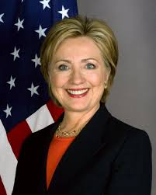
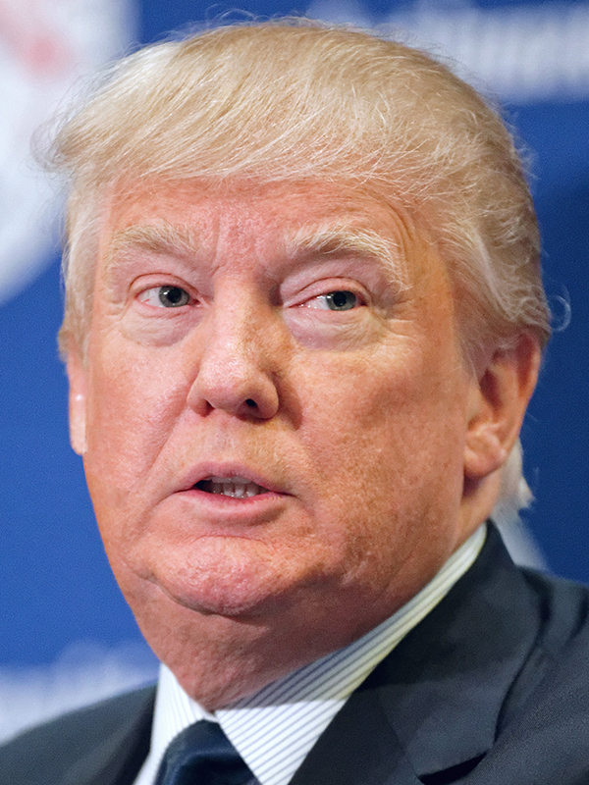
Input Images

Slide 22
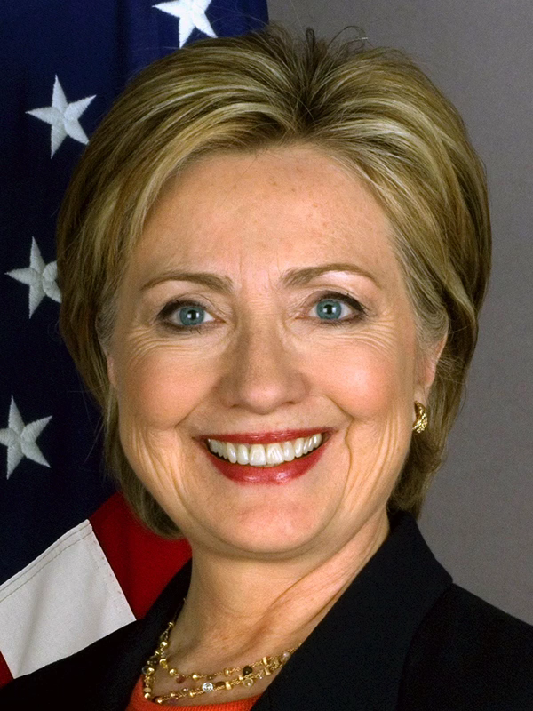
Image Morphing

Slide 23
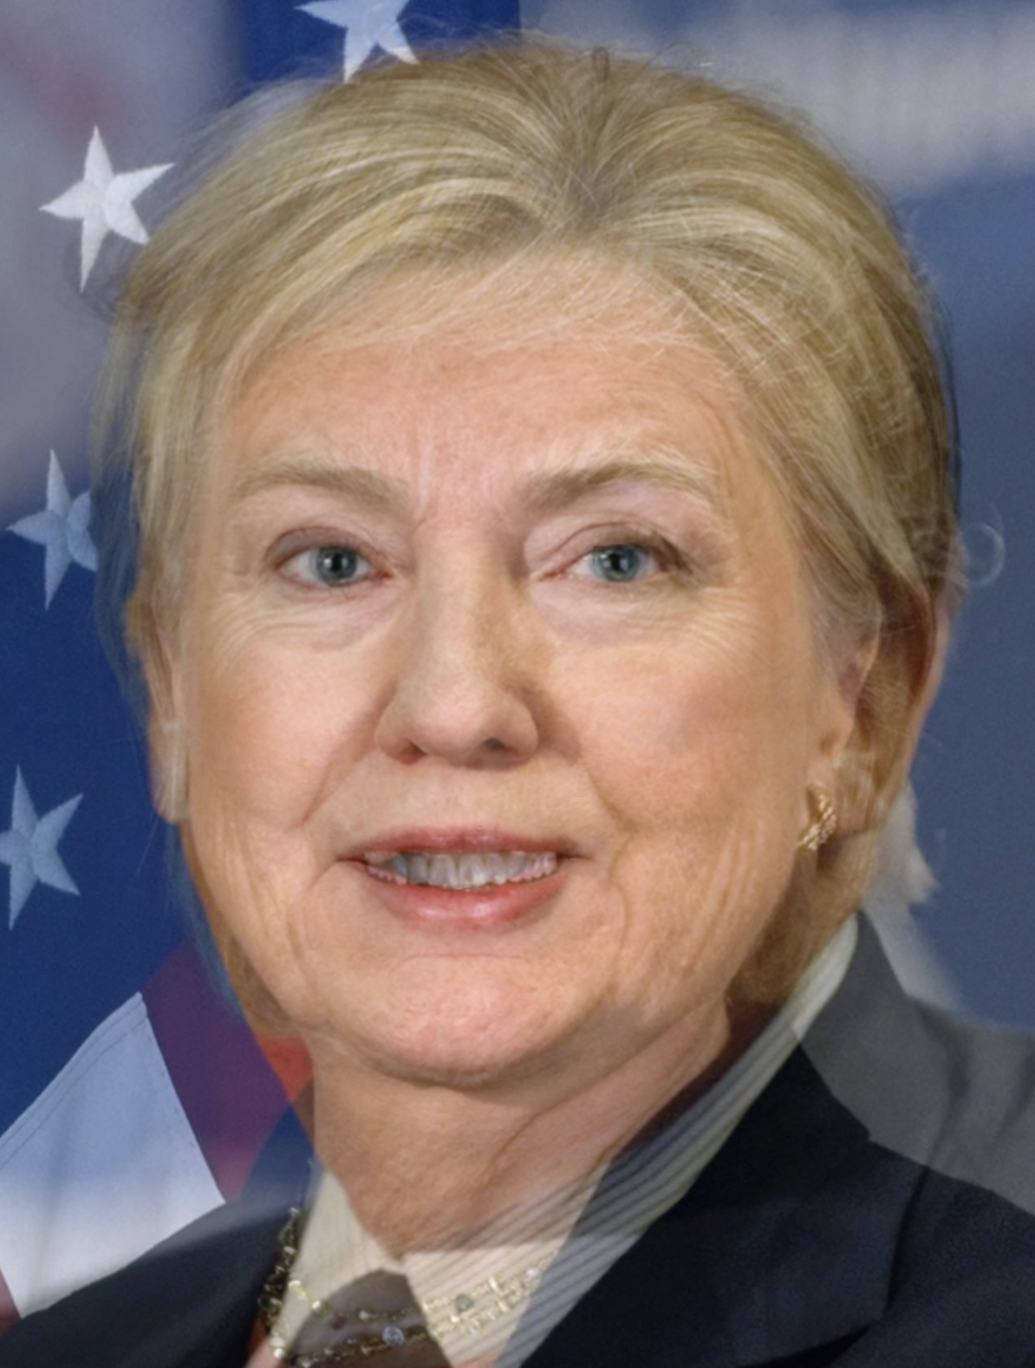
Average Face

